Slide 1
Vehicle Insurance Fraud What are the features of the claimer that will lead us to do further investigations?
Osher Reiser | 12/08/2022

Slide 2
Agenda
Background
Executive overview
Supporting data
Conclusion

Slide 3
Background

Slide 4
Vehicle insurance fraud is a bigger problem than we might guess
29,000,000,000$
a year only in the USA
According to a 2017 study by Verisk

Slide 5
…and it’s a problem that should be a concern for all of us!
200$ - 300$
of additional costs per year
According to estimates from the National Insurance Crime Bureau (NICB))

Slide 6

How does this look?

Slide 7
Executive overview

Slide 8
Main question of the analysis
What are the features of the claimer that will lead us to do further investigations?

Slide 9
The analysed data set
15,420 records
Years: 1994 – 1996
Age of claimers: 16 - 80

Slide 10
Summary of results of the analysis
There is a higher probability for people to commit insurance fraud if they are…
male compared to female
widow compared to other marital status
driving a vehicle that costs more than 69k$ or less than 20k$
commit the fraud on the same day of purchasing the insurance
between the age of 16 to 25
changing their address within 6 months after the claim

Slide 11
Supporting data

Slide 12
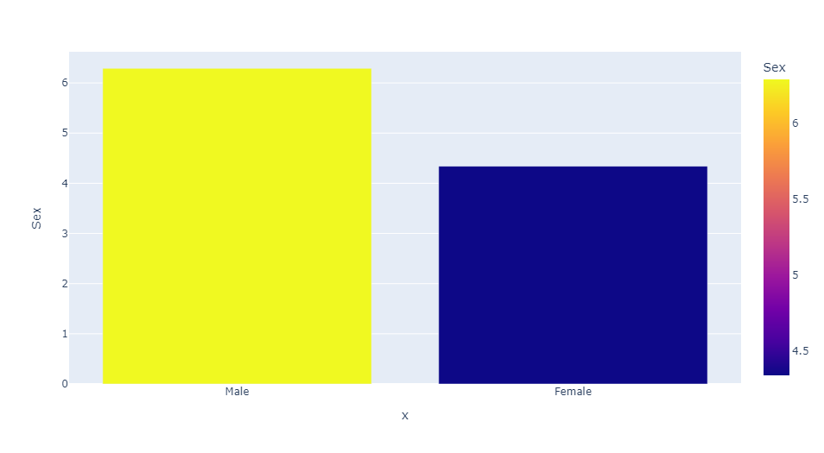
Men are more likely to commit fraud than women
6.29%
4.34%
Gender

Slide 13
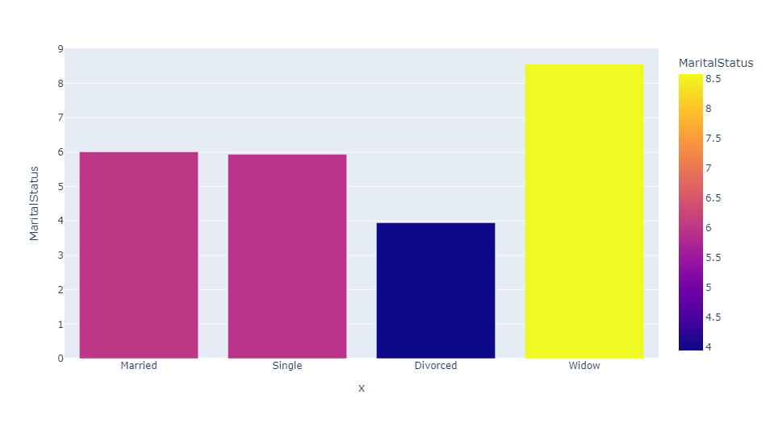
Widows are surprisingly more likely to commit fraud than people with other marital status
8.57%
6.01%
5.94%
3.95%
Marital status

Slide 14
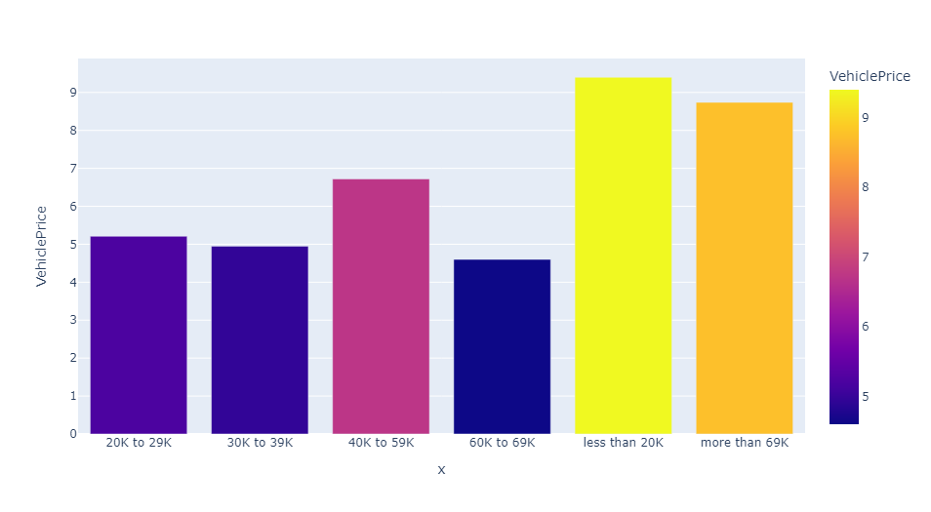
People with the highest and lowest vehicle price are more likely to commit fraud
9.40%
8.74%
6.72%
5.21%
4.95%
4.60%
Vehicle price

Slide 15
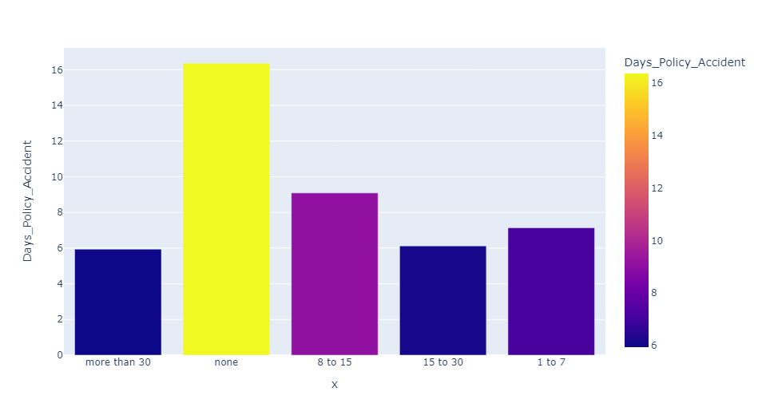
People who just purchased an insurance are more likely to commit fraud
16.36%
9.09%
7.14%
5.94%
6.12%
Days since policy to accident

Slide 16
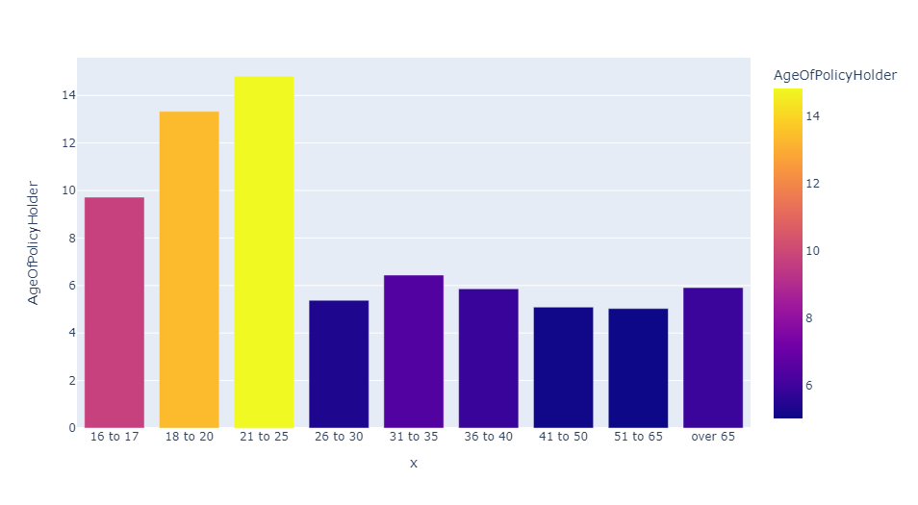
People between the ages 16-25 are significantly more likely to commit fraud
14.81%
13.33%
9.72%
6.44%
5.38%
5.86%
5.91%
5.09%
5.03%
Age of policy holder

Slide 17
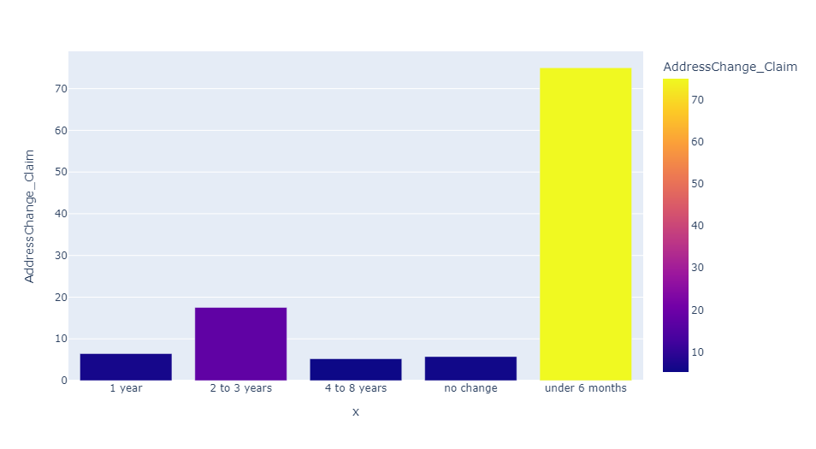
3 out of 4 people who commit fraud move within 6 months after comitting the fraud
75.00%
17.53%
6.47%
5.23%
5.76%
Address change since claim

Slide 18
Conclusions

Slide 19

A story to think of…
This Photo by Unknown Author is licensed under CC BY-SA

Slide 20
Summary of results of the analysis
He was probably
widower
driving a car that costed more than 69k or less than 20k
Started smoking the cigars the day he purchased the policy
Changed his address within 6 months after the claim

Slide 21
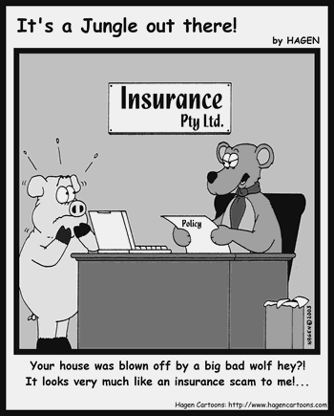
Thank you!

